Slide 1
Full Stack Web Development
Ruby On Rails / Getting Started

Slide 2
What Is Rails?
Server-side web application framework written in the Ruby programming language
Write less code while accomplishing more than many other languages and frameworks
Uses the MVC design pattern

Slide 3

What is MVC?
Model-View-Controller is an architectural pattern for implementing user interfaces
MODEL Directly manages the data, logic and rules of
the application
VIEW Output representation of information
(Templates, User Interface)
CONTROLLER Accepts input and converts it to
commands for the model or view

Slide 4
Why Use Rails?
Abstracts and simplifies common repetitive tasks. Saves TONS of time
Fast prototyping & deployment (productivity)
Vibrant community and support
CLI Tool
RubyGems library
Quality code
Testing automation
Many database options

Slide 5




Who Uses Rails
Hulu
Groupon
LivingSocial
Twitter
BaseCamp
RealEstate.com.au

Slide 6
Creating an Application
You can create a new app with
rails new myapp
Running your app
rails server or rails s
You can generate things with
rails generate or rails g
To interact with your app in a command line, use the console
rails console or rails c

Slide 7
Rails Router
The routing system takes in a url with parameters and decides which controller action method should be run
GET customers/25
Get ‘/customers/:id’, to: ‘customers#show’
config/routes.rb is where we define all of our routes

Slide 8
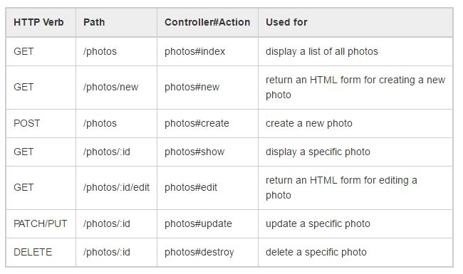
Resource Routes
Allows us to quickly declare all common routes for a given resourceful controller instead of declaring separate routes for index, show, new, edit, etc….
resources :photos

Slide 9


